Slide 1
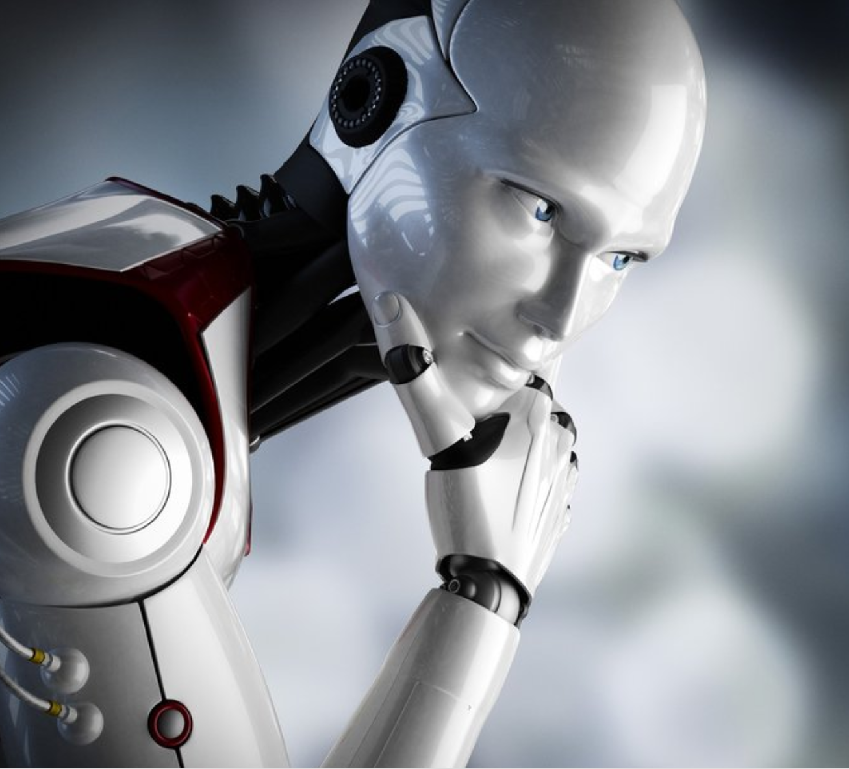
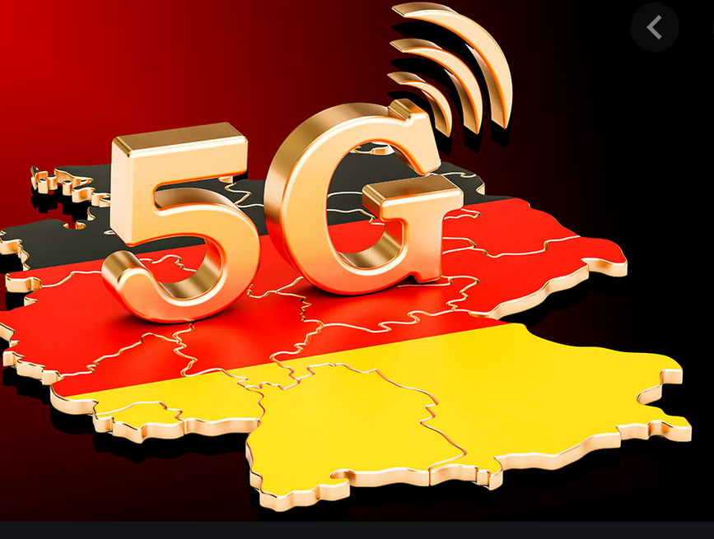

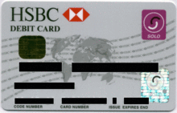


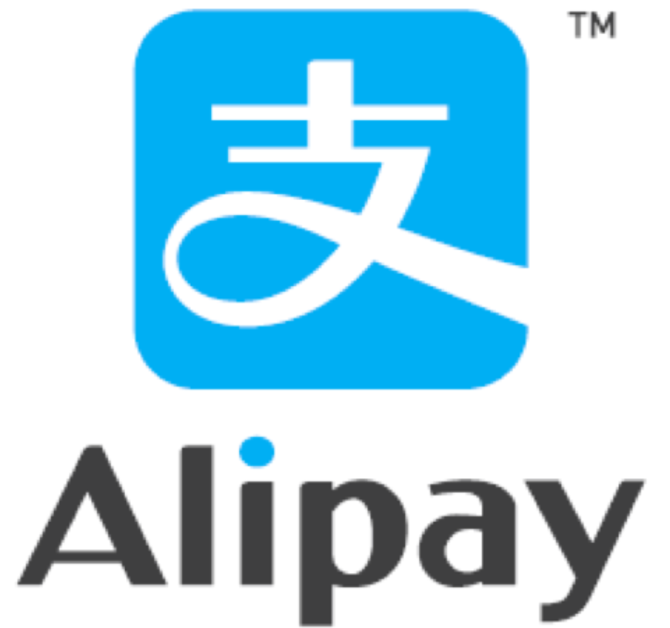
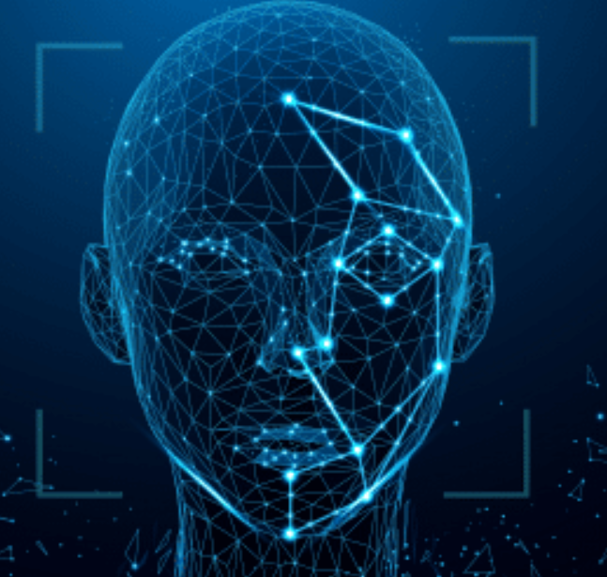


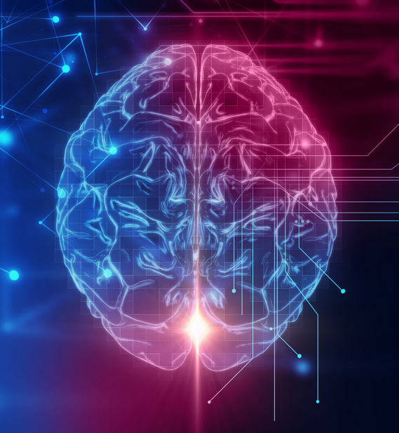
Cont…
More data we have , better advise u get!
- RA, 2017
1000 X faster than 4G
You don’t need plastic to make a payment
Move Money
Store Value
Access Credit
KYC- Kill Your Customer
Identity / Algorithmic Compliance Program
Voice is the next big technology – Just ask Alexa!
Digital Finance fundamentals
Core Architecture of FinMkt
Behavioral Psychologist
When / why / Motivation – FinMkt
e.g. PERCEPTRONS
Uber doesn’t want to be a bank, they needed the utility of the bank
Market pattern analysis – Data Science
FinMkt – Financial Market

Slide 2
Technology Stack Financial Market
Bigdata
Blockchain
AI
Financial Market
ML

Slide 3
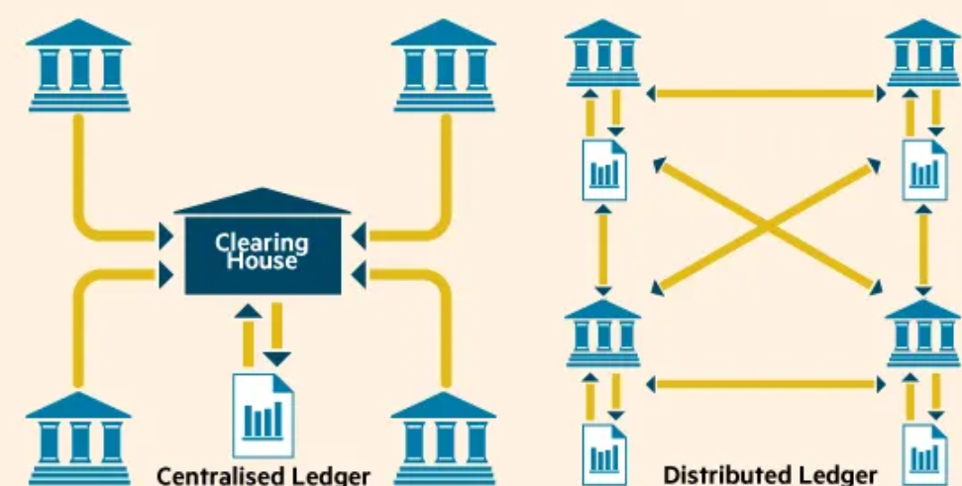
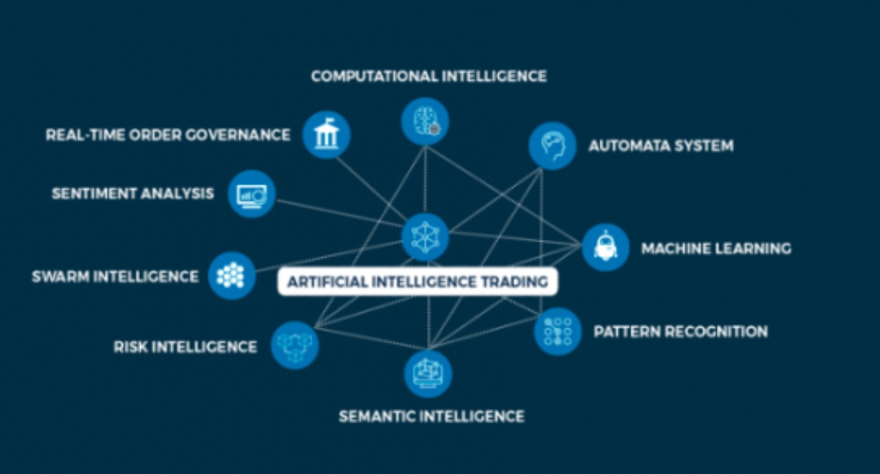
Cont… Use Cases
Blockchain
DLT – decentralized ledger of all txns across a peer2peer n/w, when participants confirm txns without the need of central authority. E.g. cryptocurrency Bitcoin.
AI
Portfolio / Asset Management, Robo Advisor
Fully Automated AI Trading by EPOQUE – Swiss company
Strategy Engine – observes and analyses potential trades.
Order Engine – creates orders and performs operational actions.
Logical Engine – handles active orders and uses machine learning to improve its performance.
BigData
BigData Lake Arch used in financial market –these clusters enable huge amount of data to be processed - perform necessary calculation – Scaling – Purpose like Trading Surveillances.

Slide 4
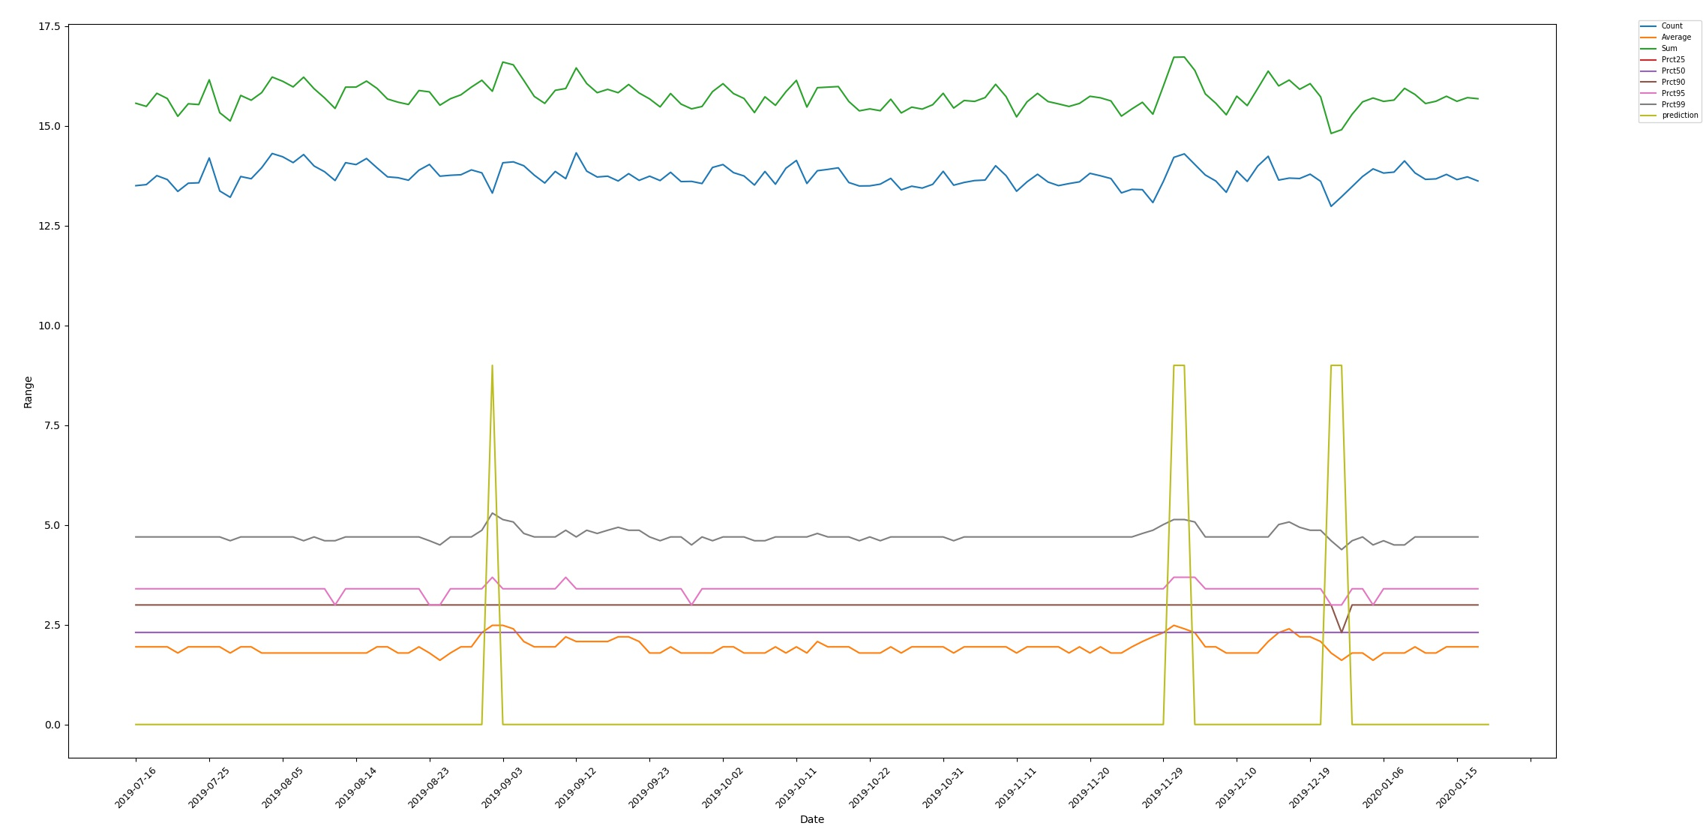
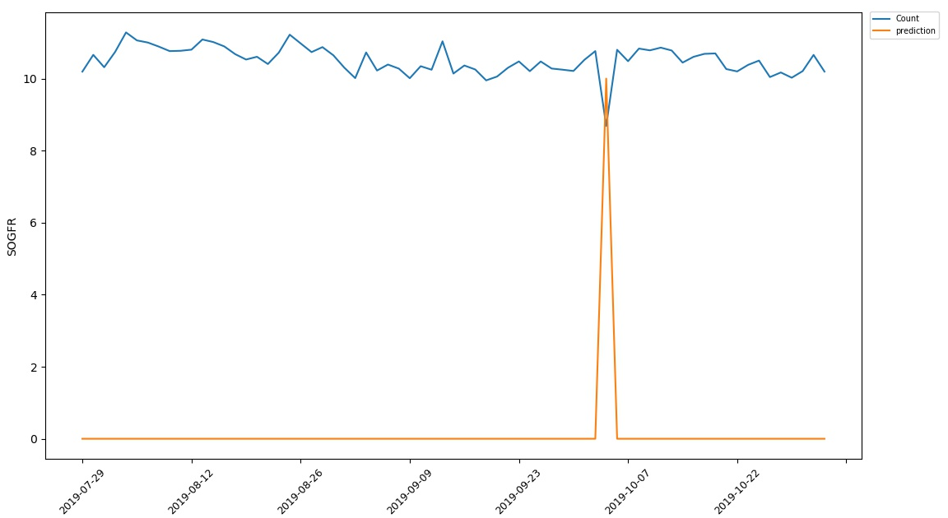
Cont… Use Cases
ML -Summary of anomalies based on round trip time for all trade request per day
The model characterizes system behavior over 9 different metrics to define ’anomalous patterns’ in the data.
The data here predicts anomalous patterns at the end of every quarter.
The second spike close to the end shows another surge around Christmas period, a normal phenomenon.
ML - Trading behavior for a known member for a given product
The model learns the trends in the trading patterns over time and highlights any deviation from norm as anomalies as shown in the beginning of Oct 2019.
Evident from the graph the user shows a dynamic trading behavior from the beginning, however this model only focuses on events which shown significant gradients over the normalized behavior.

Slide 5
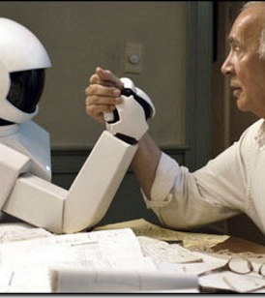
By 2030! -what can be envisaged
1 programmer can replace 5 traders – Goldman Sachs
Machine vs. Man, but we win over machines – Jack Ma
Job accuracy will be 15-20 X more than a human
Completely new skill sets for the regulators
More people will use digital access to financial services on daily basis
Digital Relationships and Digital Engagements
Cannot scale your business based on pure human efforts
Slowly replace the traditional baking with the new value of digital experiences
Industry needs new personality, new skill sets
Data Scientist – who understands data patterns
Creative programmers – AI, ML, NLP, Automation etc.
Blockchain experts

Slide 6
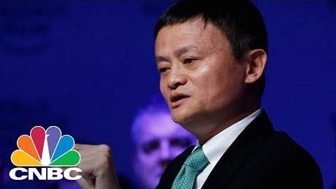
Digital Onboarding is the FUTURE!!!
Let’s hear Mr. Jack Ma – Richest Chinese Business Magnet – estimated worth $38 billion

Slide 7

Planning is bringing the future into the present, so that you can do something about it now.
- Alan Lakein

